Slide 1

United States Automobile Accidents in Relation to the Adoption of Smartphones and Mobile Phones: 2004 – 2018 T Team Members: Zach Elson, Ben Fox, Katherine Sullivan, Martin Wehrli

Slide 2

Questions:
Has the adoption of smart phones affected the incidence of traffic accidents (including fatalities) nationally?
Does age play a factor in distracted driving fatalities?
How has the adoption of smart phones affected the incidence of traffic accidents in specific states?
How has the adoption of mobile applications affected the incidence of traffic accidents in these states?

Slide 3
Hypothesis:
The adoption of smartphones has increased the total amount of all automobile accidents in the United States.
Specifically, fatal accidents have increased with the adoption of smart phones.
There will be a noticeable difference in the amount of automobile accidents based on age. Specifically, younger people (15 – 20 years old) will have a higher number of accidents.
The popularity and adoption of mobile apps has increased the amount of non-fatal and fatal accidents.

Slide 4
Data Sources:
Automobile Accident Data:
National Highway Traffic Safety Administration (NHTSA) website
CSV downloads
https://www.nhtsa.gov/)
Fatality Analysis Reporting System (FARS) Application Program Interface (API)
API (Pandas)
www-fars.nhtsa.dot.gov/querytool/
Registered Drivers by State
CSV download (Pandas)
Google Public Data
Mobile Adoption Data
Mobile App adoption, Mobile phone and smartphone adoption
Pew Research, Statista.com
National Smartphone Data
Ownership Rates
Statista.com

Slide 5
Data Exploration and Cleanup
Generally, wee utilized several methods to clean the data including:
Formatting data type elements
Indexing and re-indexing data
Dropping null values
Formatting data element types
Renaming columns
Transposing numbers

Slide 6

National data – NHTSA website:
For aggregated national data, we used the NHTSA website to download CSV files.
Clean-up on these files were minimal and included renaming columns, merging data, dropping null data, and converting strings to floats.

Slide 7
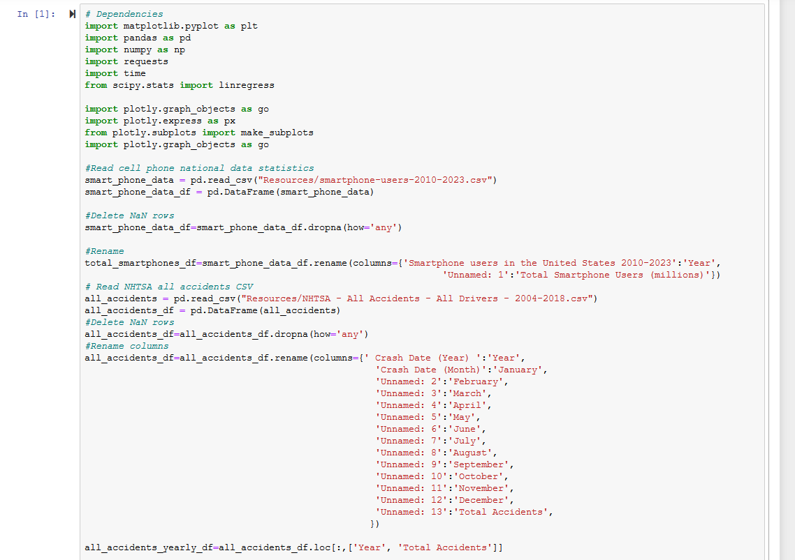
National Data – Five CSV files were merged and cleaned.
One file for the smart phone population
Three bucketed age groups files plus the grand total

Slide 8
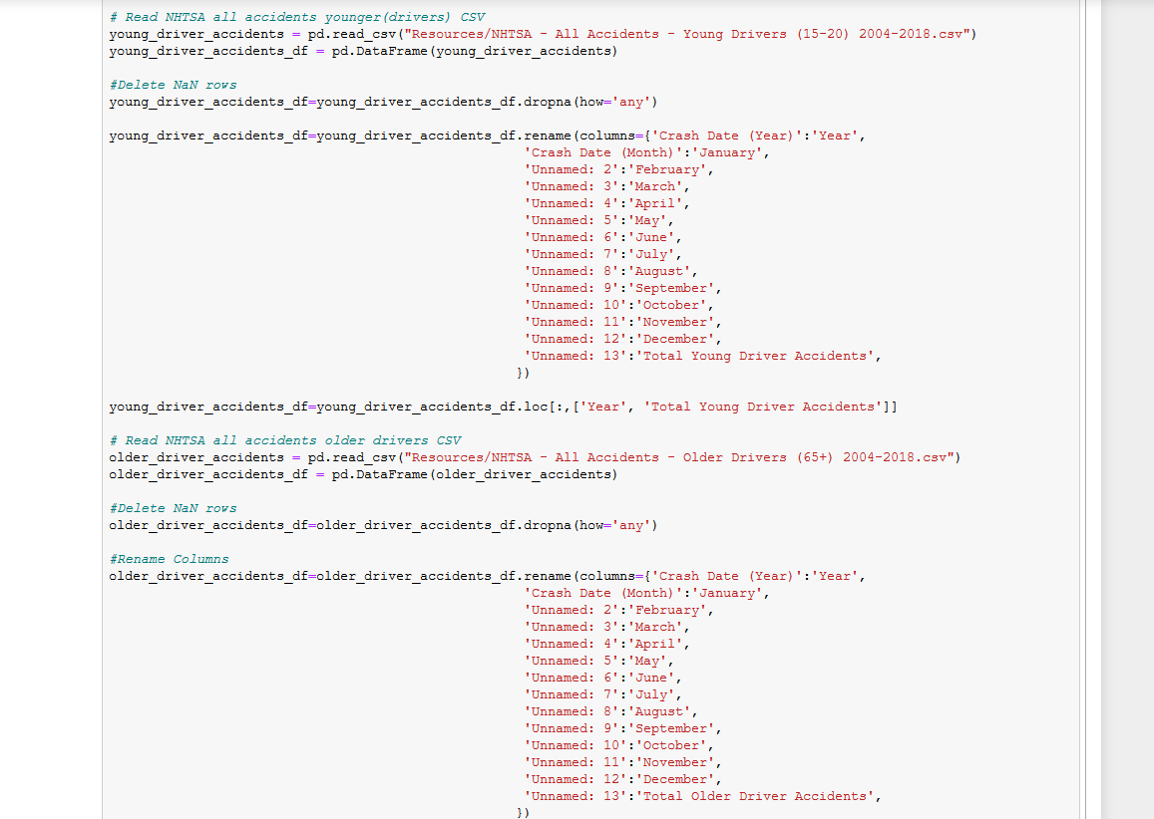

Slide 9


State Level Data - API: FARS
With regards to state level accident data, record searches were systematically limited to 5000 records. So, we judgmentally selected 8 states instead of attempting all 50.
Data clean-up was minimal. Once we determined the data points needed, the API delivered clean information.

Slide 10
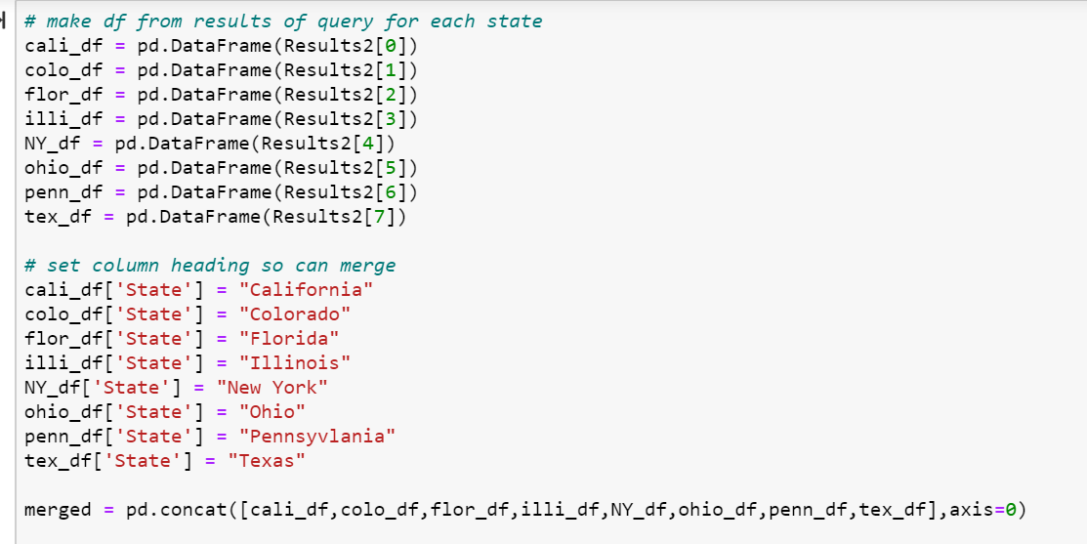
API: FARS (continued)
A dataframe was built for state accident data and then merged into one larger dataframe.

Slide 11
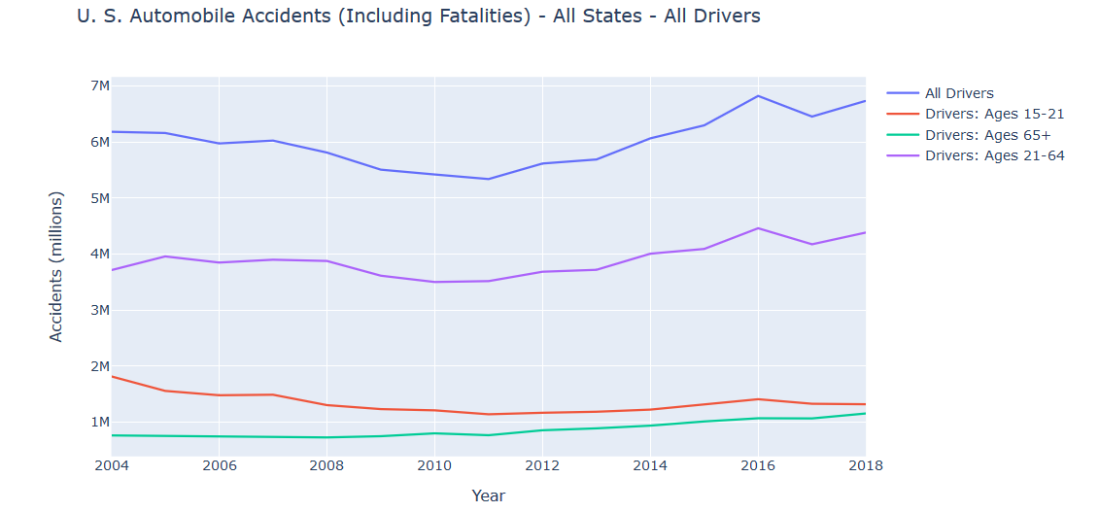
Data Visualizations:

Slide 12
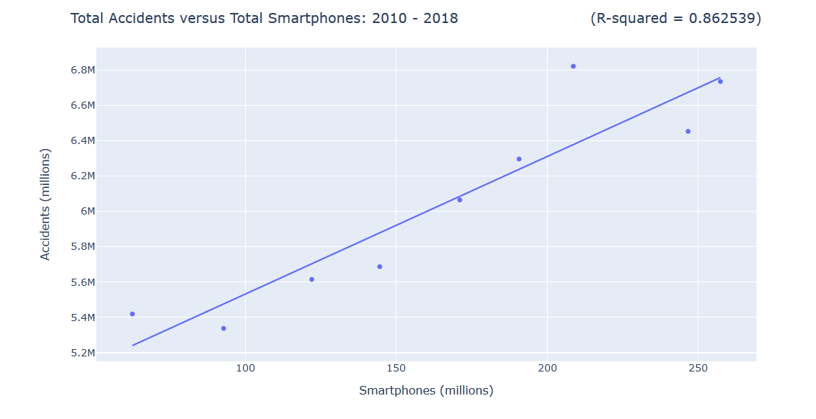

Slide 13
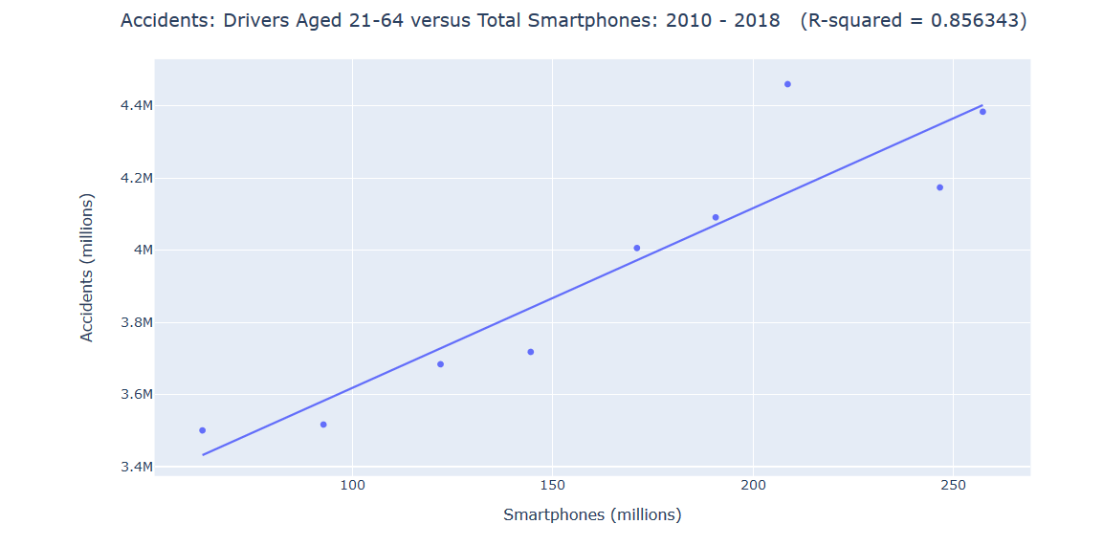

Slide 14
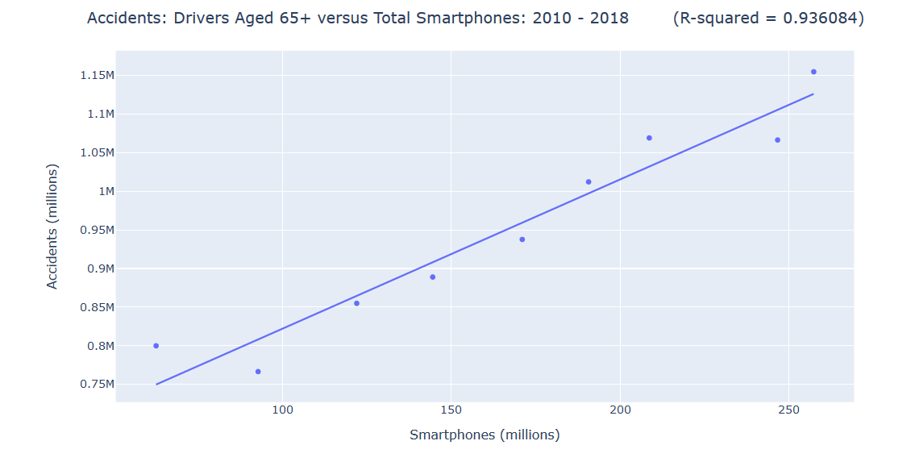

Slide 15
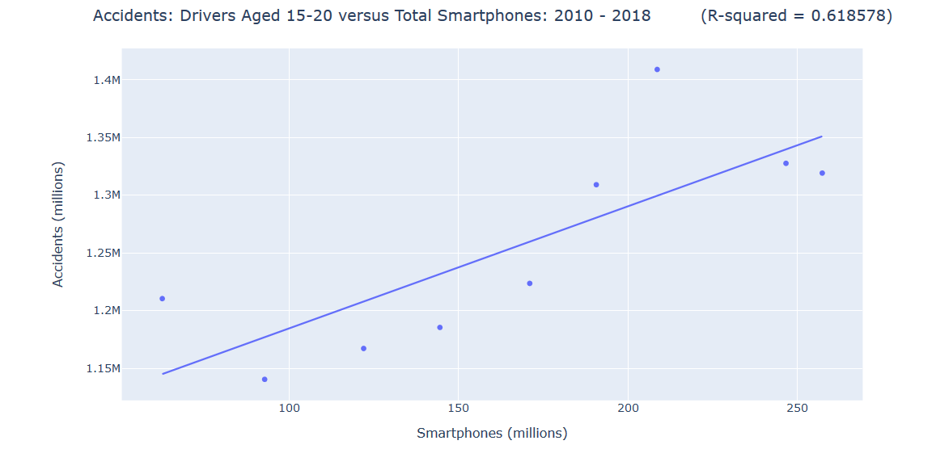

Slide 16
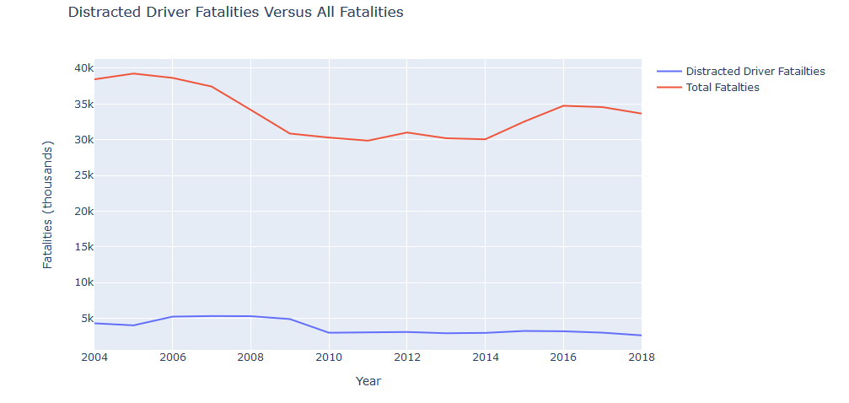

Slide 17
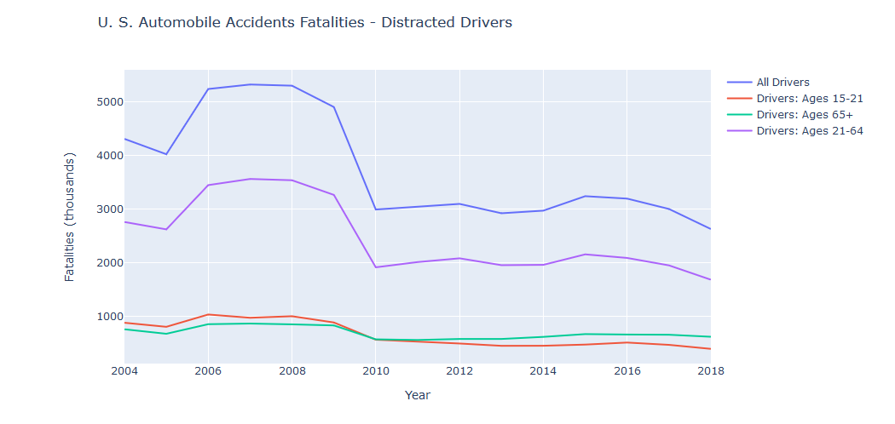

Slide 18
National Data and Conclusions:
On a national level between 2010 and 2018, our regressions indicate that increased smartphone ownership correlated to an increase in automobile accidents.
On a national level from 2010 – 2018, our regressions indicated that increased mobile phone ownership was not correlated to fatal accidents.
However, a spike in fatal accidents from 2006 through 2009 appears to be related to the proliferation of cell phones in everyday life.
However, because this data contains limited data points, the results are not necessarily reliable.

Slide 19
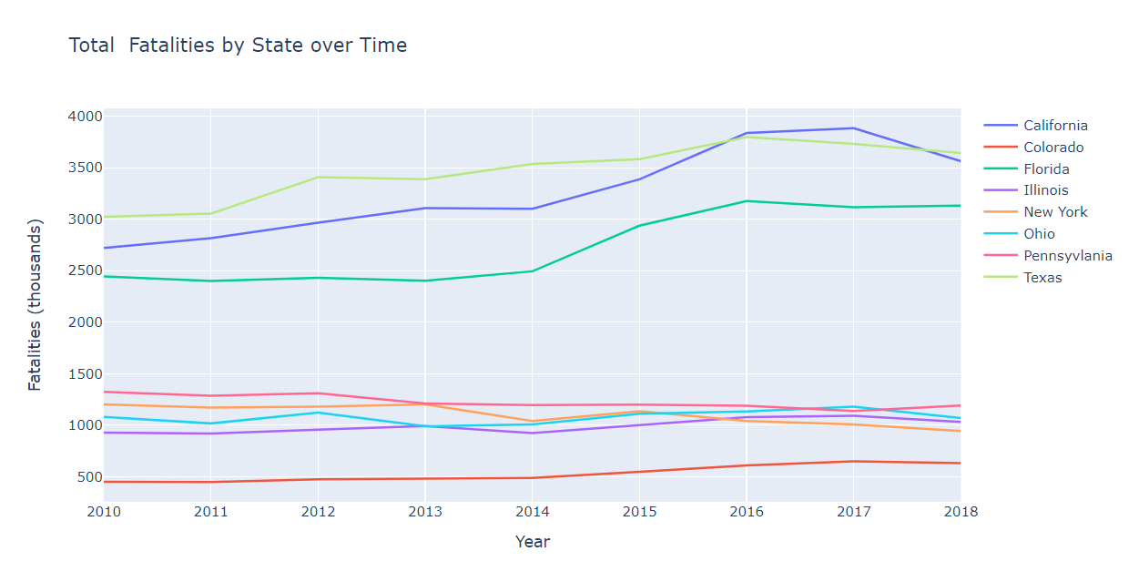
State Data:

Slide 20
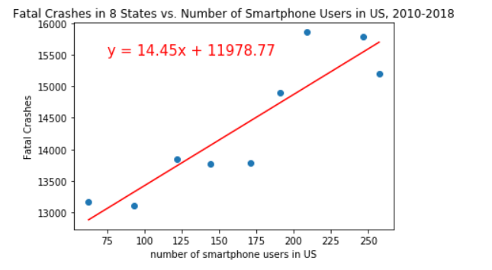
R-squared is: 0.9003186964685078
p-value is: 0.0009328845788830946

Slide 21
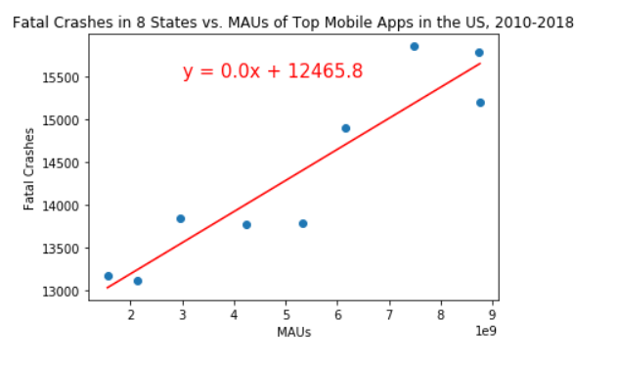
R-squared is: 0.9287022633277064
p-value is: 0.00029703475180740437

Slide 22
State Data and conclusions:
A regression of fatal crashes in 8 states versus the number of smartphone users resulted in an R-squared value of 0.900 and a p-value of 0.0009.
A regression of fatal crashed in 8 states versus the number of monthly active users of mobile apps resulted in an R-squared 0.929 and a p-value of 0.0003.
These values would suggest that there is indeed a relationship between fatal crashes and mobile phone users as well as fatal crashes and MAUs of mobile apps.
However, because this data only contains 10 data points (years) the results are not very reliable.

Slide 23
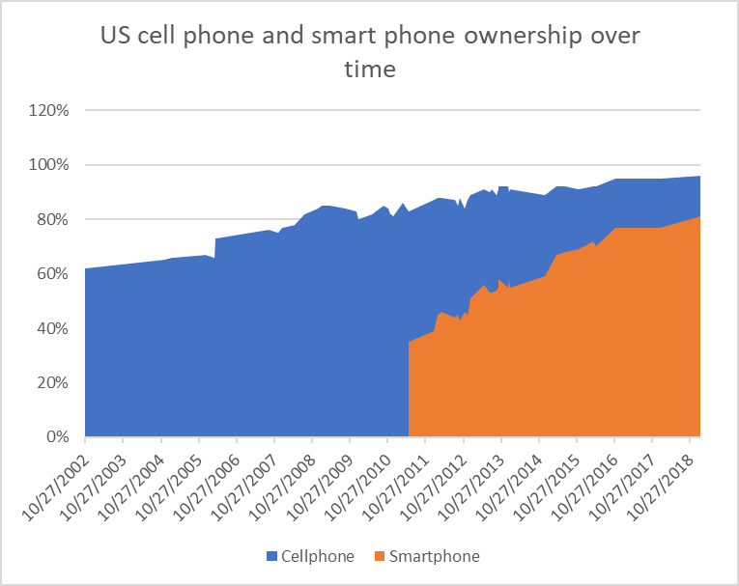

Slide 24
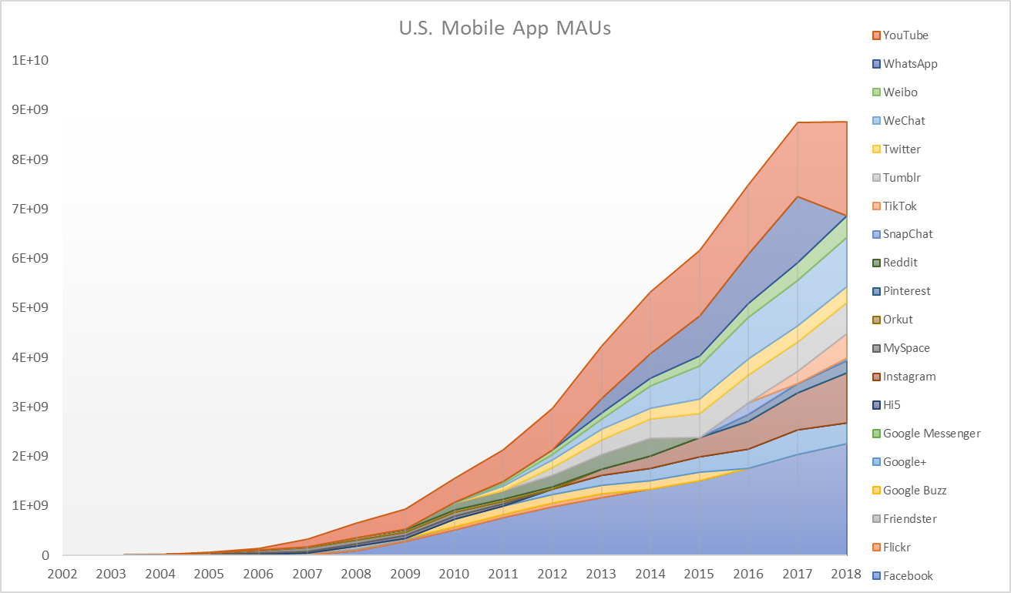

Slide 25
Acknowledgment of Limitations
API
Limitation of 5000 records.
Cell Phone / Smartphone ownership data and Mobile MAU data
Free data available was limited to aggregated US totals by year.
Data from more frequent timepoints would improve results.

Slide 26
Summary
How has the adoption of mobile and smart phones into everyday life affected the incidence of traffic accidents in nationally?
On a national level between 2010 and 2018, our regressions indicate that increased smartphone ownership correlated to an increase in all automobile accidents.
How has the adoption of mobile and smart phones into everyday life affected the incidence of traffic accidents in specific states?
In the 8 most populous states, our regressions indicated that increased smartphone usage correlated to an increase in fatal accidents.
In the 8 most populous states, our regressions indicated that increased MAUs of mobile apps is correlated with an increase in fatal accidents.
Does age play a factor in distracted driving accidents?
Our regressions indicated that age does not play a significant factor accident frequency.
Between 2010 and 2018, increased smartphone ownership was not correlated to increased fatalities related to distracted driving.

